Slide 1
Plagiarism Detection Engine for Academic Submissions​
P. Jahnavi 2520090012​
SRR. Keerthi 2520090150​

Slide 2
Abstract​
The Plagiarism Detection Engine for Academic Submissions is a fast and user-friendly software application designed to preserve academic integrity by analyzing assignments and research papers for copied content. It works by preprocessing text—removing unnecessary characters and extracting key words—and comparing it against reference databases using pattern-matching and similarity techniques. The system then generates a detailed report featuring a similarity score and highlighted matching text, allowing educators to evaluate originality quickly and efficiently without manual effort. Looking forward, future upgrades plan to integrate machine learning and online database support to enhance detection accuracy across larger document collections.​

Slide 3
Introduction​
Maintaining academic integrity is tough nowadays because digital resources are everywhere, and checking papers manually takes too much time and easily leads to mistakes. This engine solves that problem by automating the entire process: it takes student submissions, cleans up and prepares the text, converts the words into mathematical patterns, and runs similarity checks. In the end, it gives educators a clear similarity percentage alongside a highlighted report of matching text, making it easy to see copied content and make fair, evidence-based decisions.​

Slide 4
System Requirements​
Software​
Programming Language: Java​
Development Environment: VS Code​
Frontend: React.js​
Database: MySQL​
Hardware​
Processor: Intel Core i3 ​
RAM: 4 GB​
Storage: 500 MB for application logic

Slide 5
Literature Survey​
Plagiarism detection literature emphasises preprocessing, pattern matching and robust similarity measures. Common approaches include TF–IDF, n-grams, Cosine Similarity and Jaccard index. Recent work incorporates NLP and machine learning to detect paraphrase and semantic similarity beyond verbatim copying. Our proposed engine builds on these foundations — prioritising reliable preprocessing and proven similarity metrics now, with a roadmap toward ML-enhanced semantic detection and online corpus access.​

Slide 6
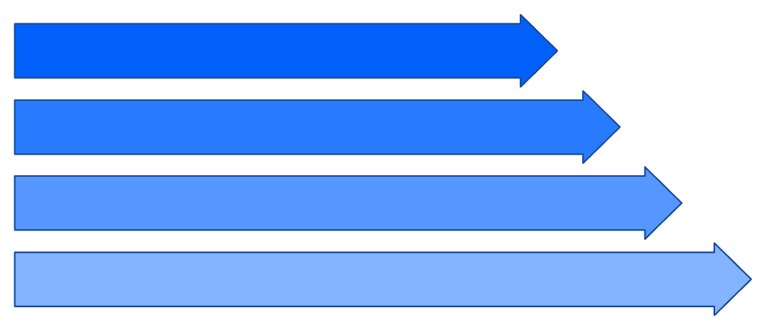
Methodology​
Document Input​
Text Preprocessing​
Feature Extraction​
Similarity Comparison

Slide 7
THANK YOU

